Slide 1
ALGORITHM
.

Slide 2
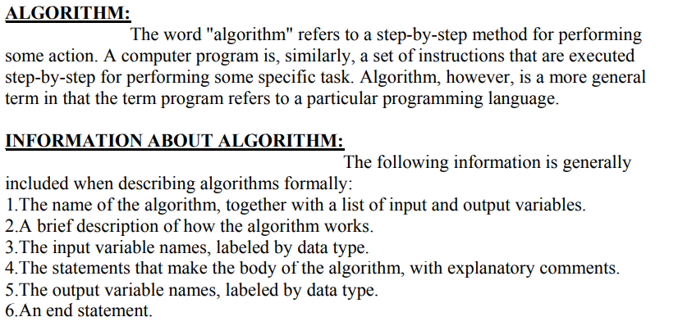

Slide 3
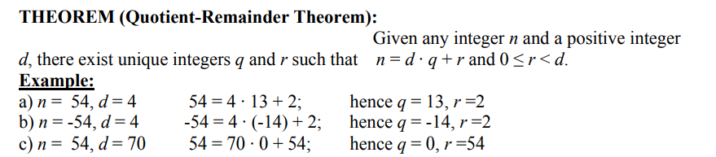
{Given a nonnegative integer a and a positive integer d, the aim of the algorithm is to find integers q and r that satisfy the conditions a = d · q + r and 0 ≤ r < d.
ALGORITHM
Input: a ,d {nonnegative integer}
r := a, q := 0 // initialize
while (r≥ d) //{Repeatedly subtract d from r until a number less than d is obtained.
r := r - d q := q + 1 //Add 1 to q each time d is subtracted.
end while
Output: q, r
end

Slide 4
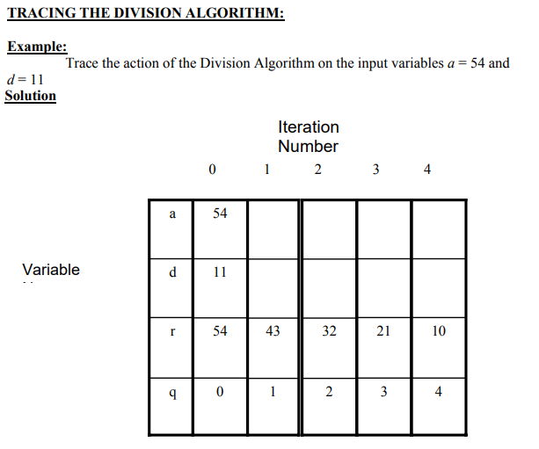

Slide 5
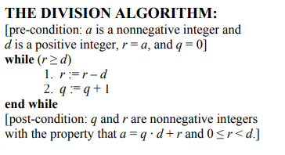
PRE-CONDITIONS AND POST-CONDITIONS:
Consider an algorithm that is designed to produce a certain final state from a given state.
Both the initial and final states can be expressed as involving the input and output variables.
Often the predicate describing the initial state is called the pre-condition of the algorithm and the describing the final state is called the post-condition of the algorithm.

Slide 6
LOOP INVARIANTS:
The method of loop invariants is used to prove correctness of a loop with respect to certain pre and post-conditions. It is based on the principle of mathematical induction.
[pre-condition for loop]
while (G)
[Statements in body of loop].
end while
[post-condition for loop]
DEFINITION:
A loop is defined as correct with respect to its pre- and post-conditions
if, and only if, whenever the algorithm variables satisfy the pre-condition for the loop and
the loop is executed, then the algorithm variables satisfy the post-condition of the loop.

Slide 7
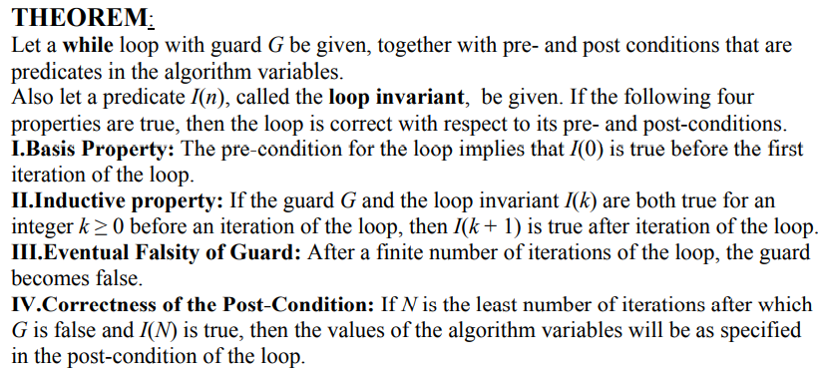

Slide 8
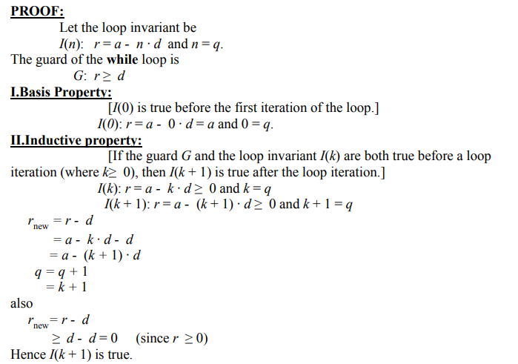

Slide 9
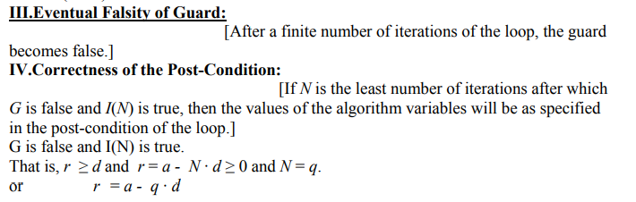


Slide 10
